Slide 1
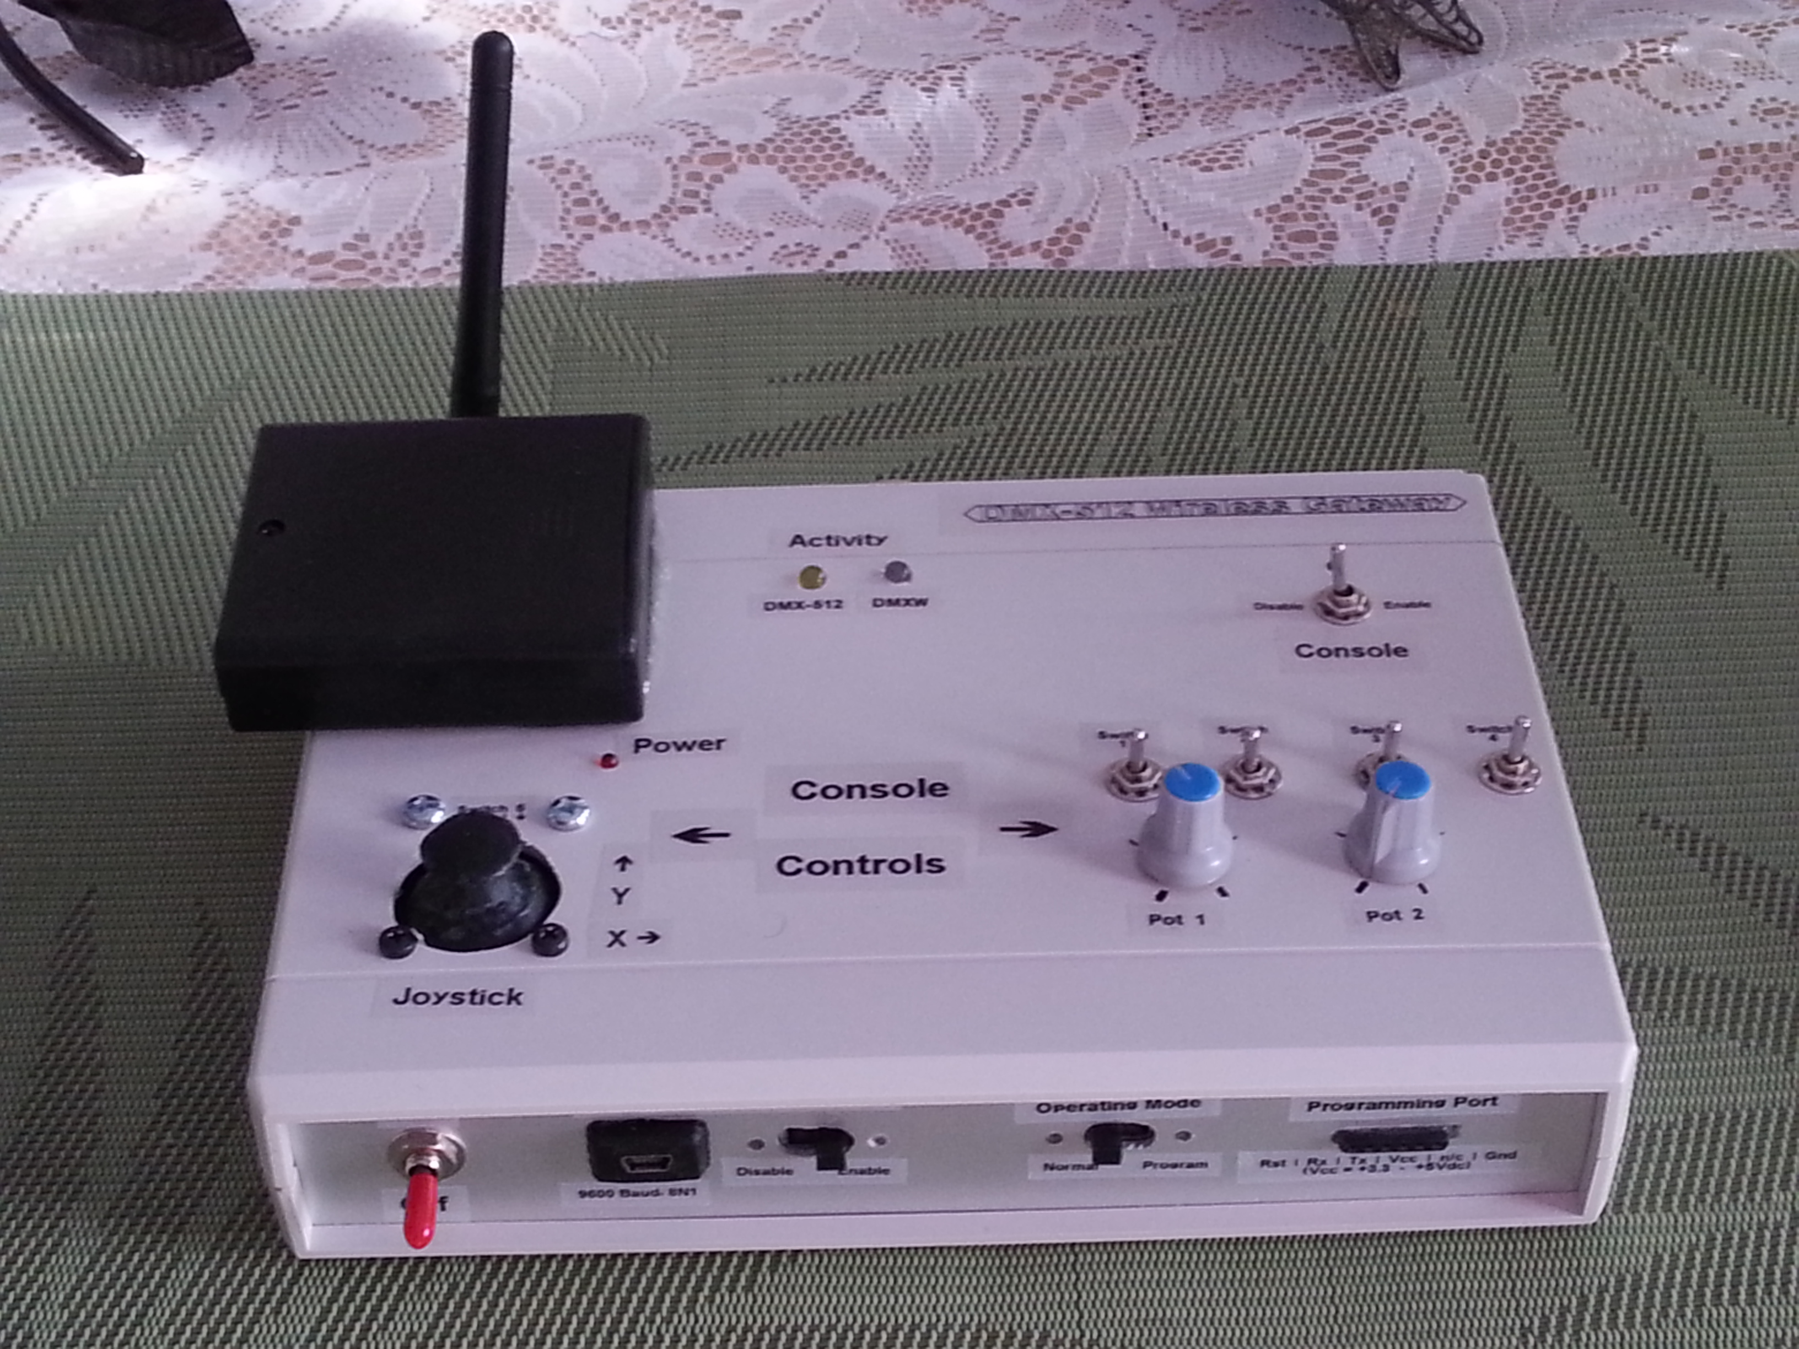
DMXW Gateway Construction Summary
John van Schouwen
2014-03-14

Slide 2
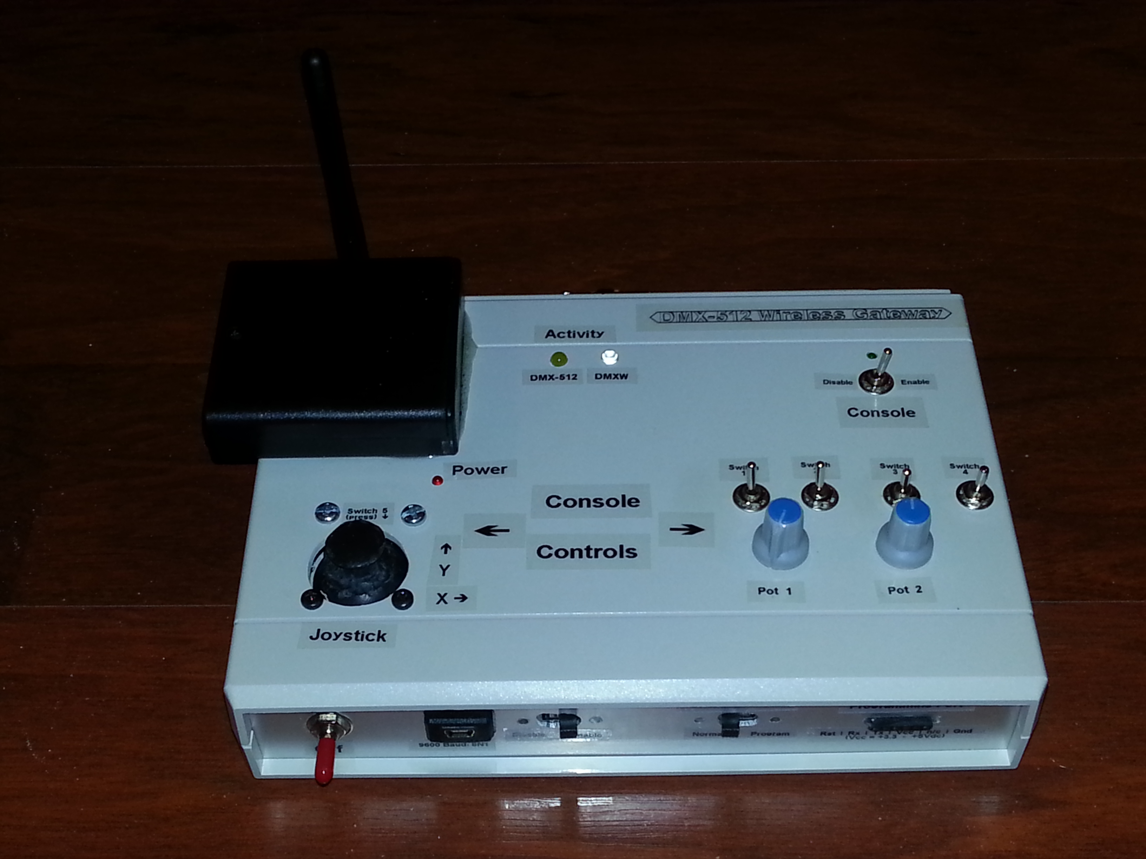

Slide 3
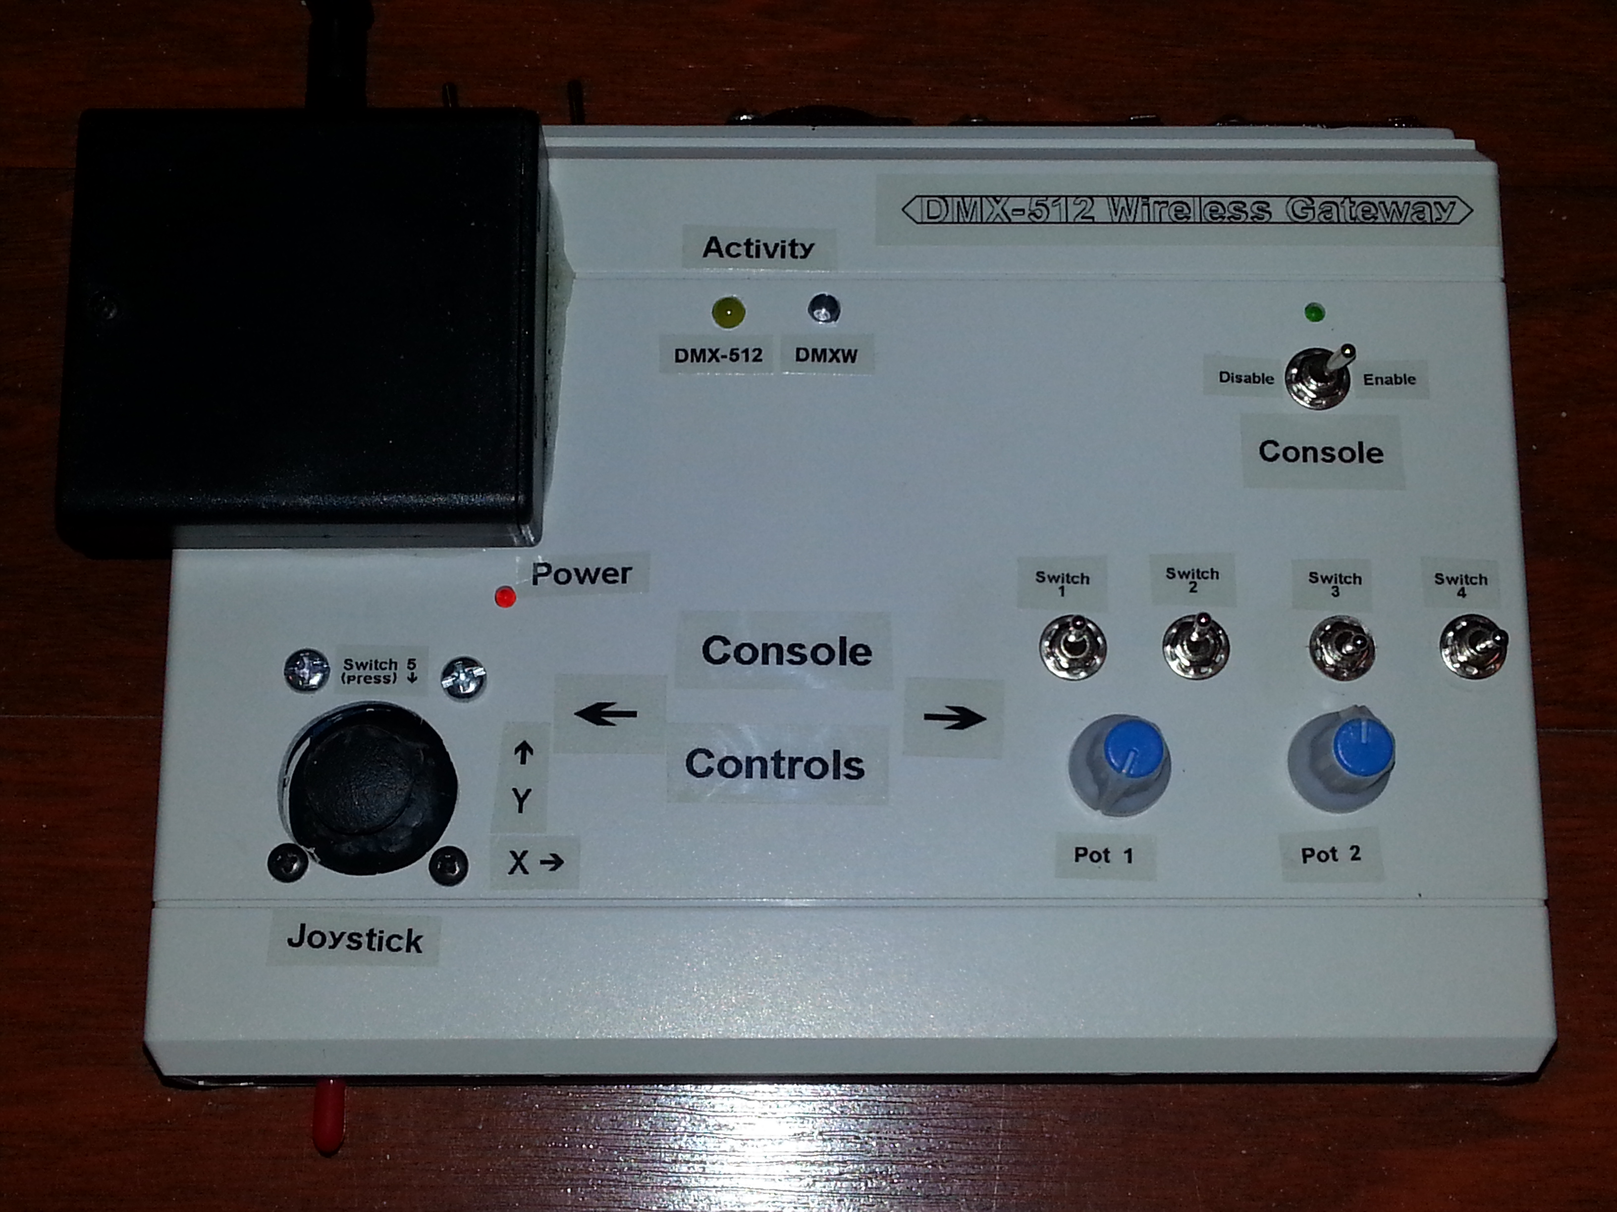

Slide 4
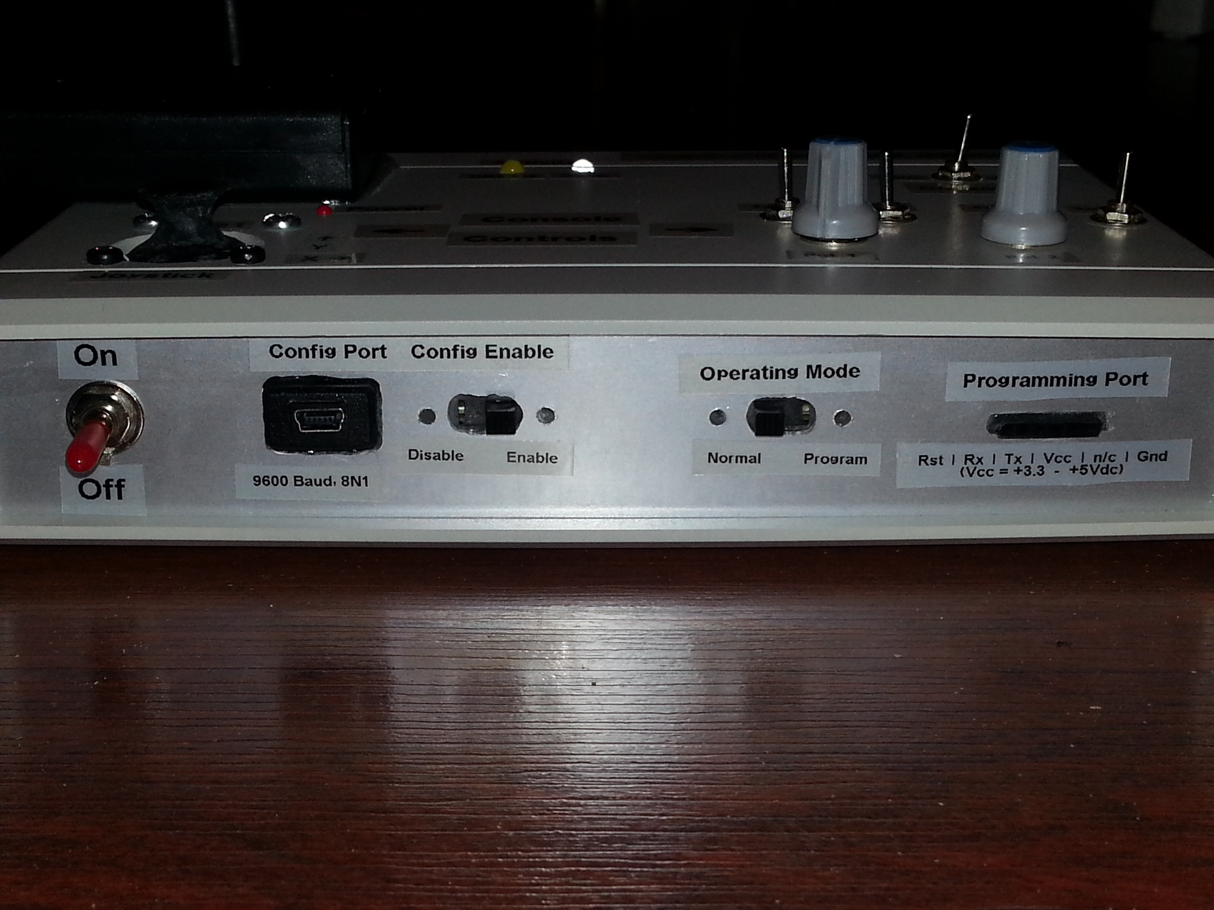

Slide 5
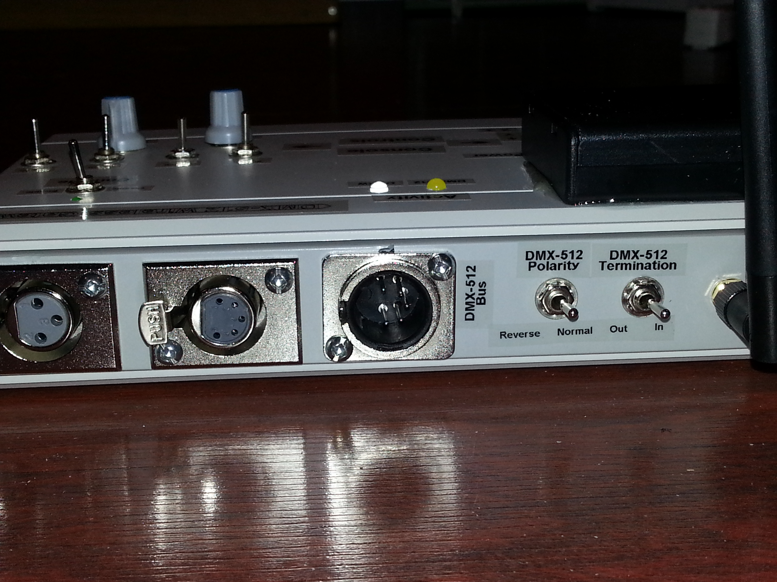

Slide 6
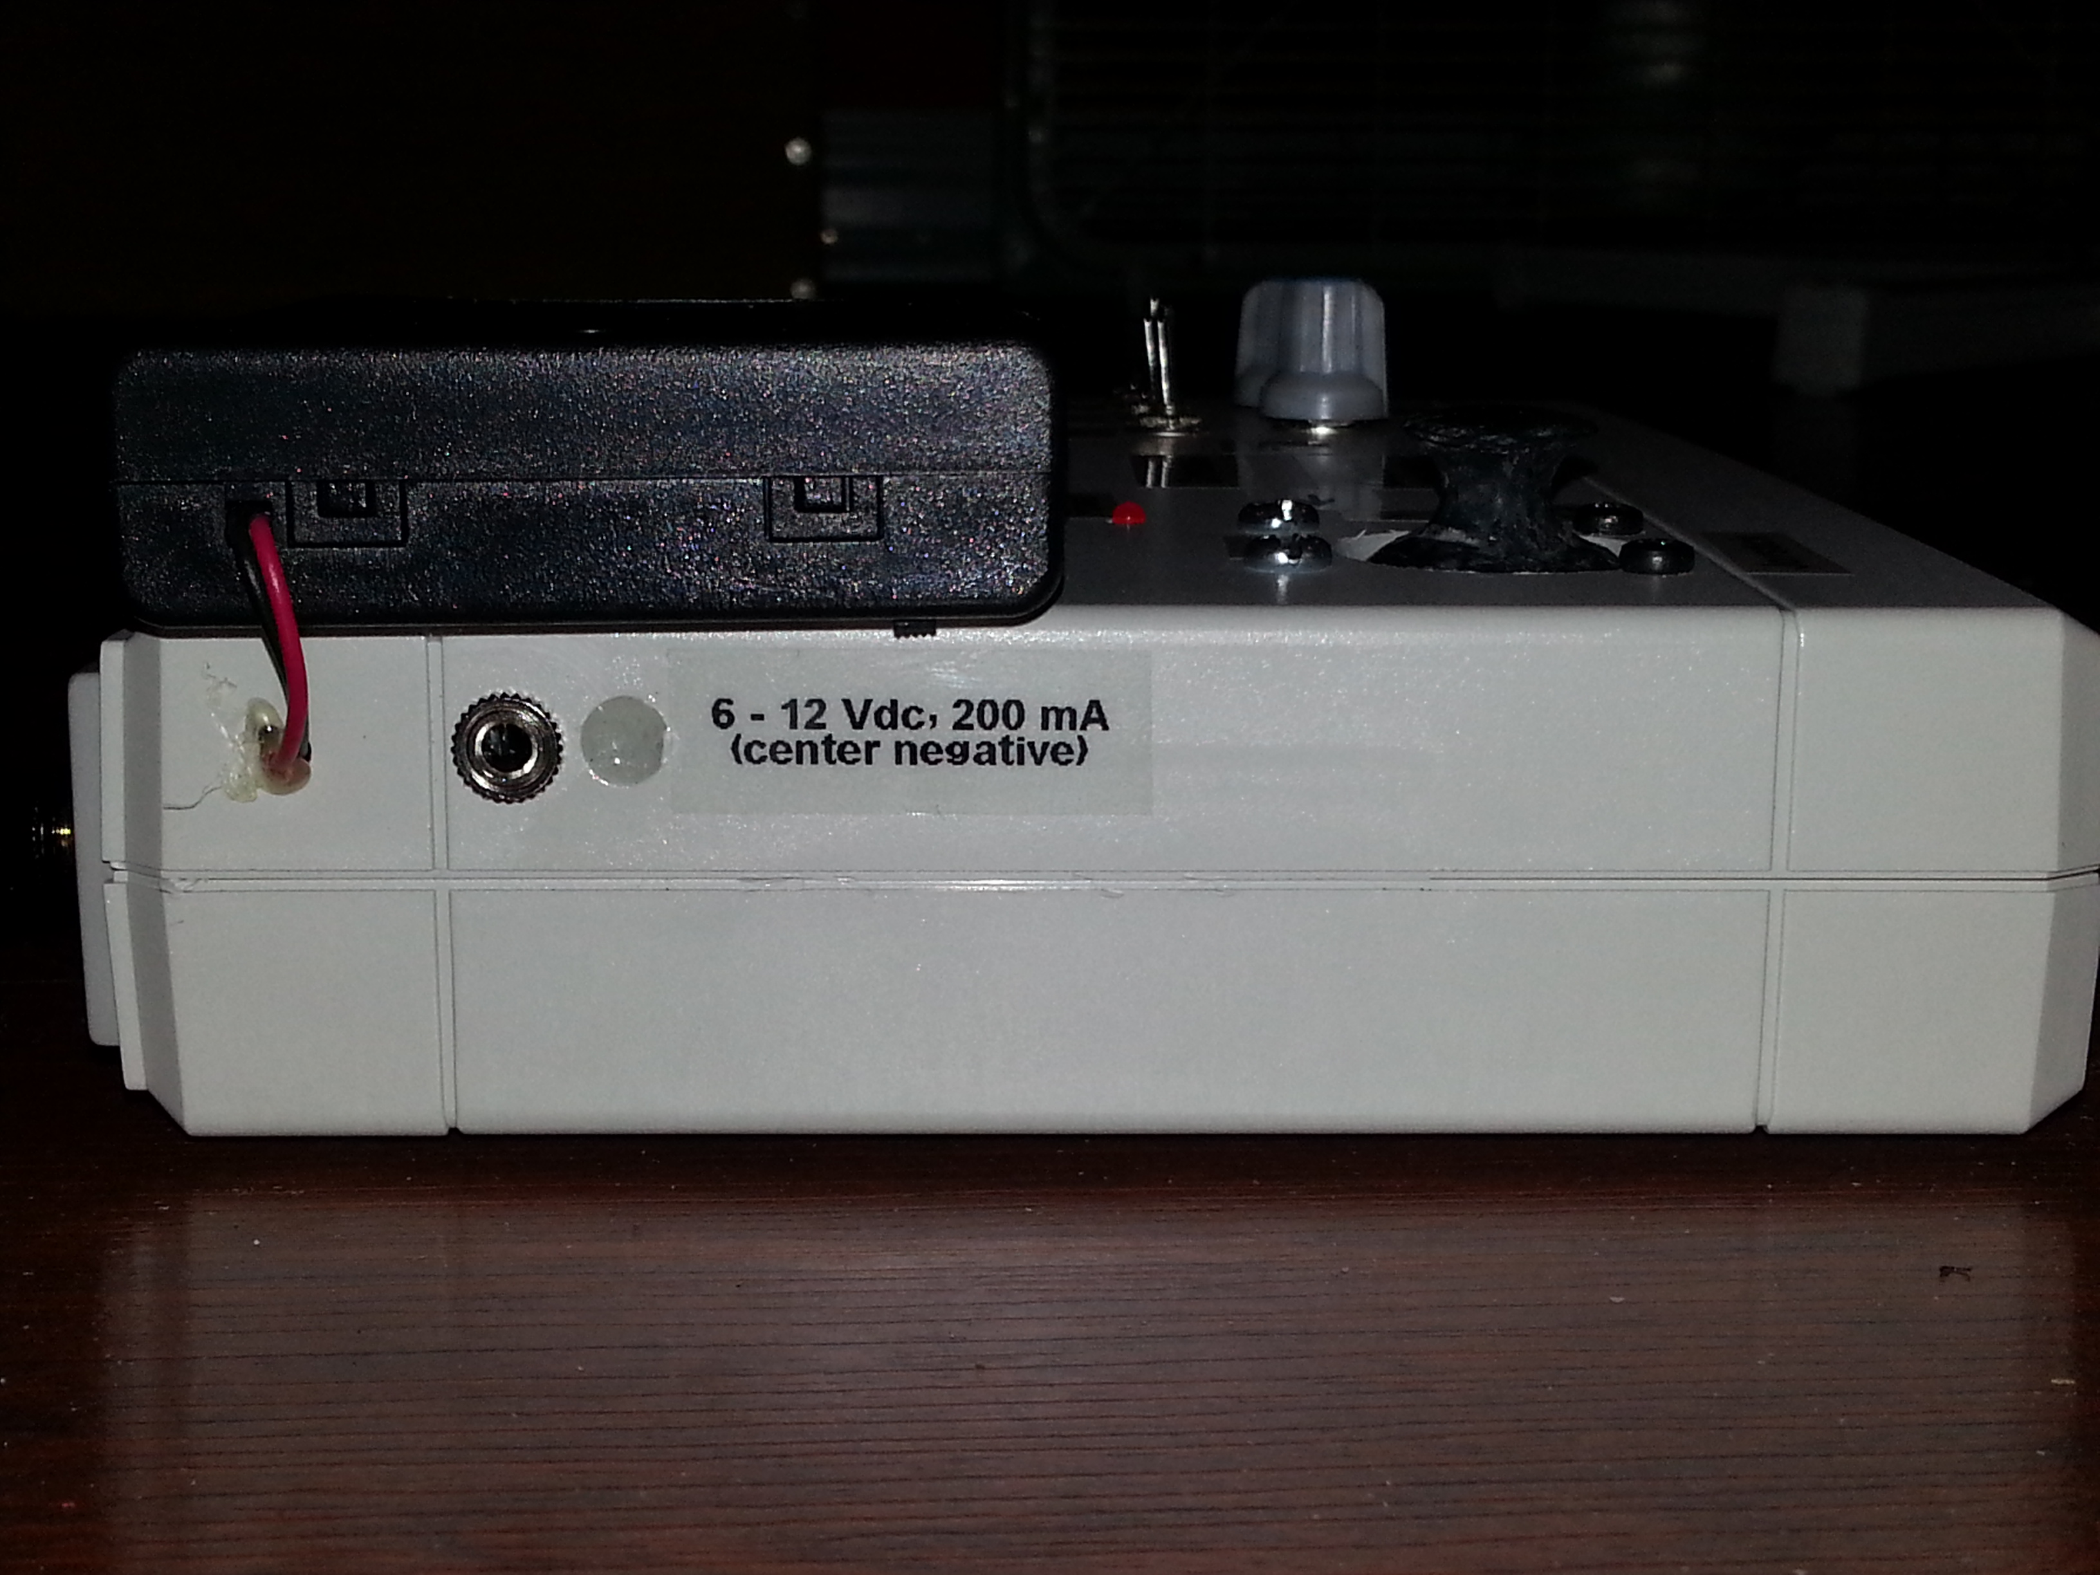

Slide 7
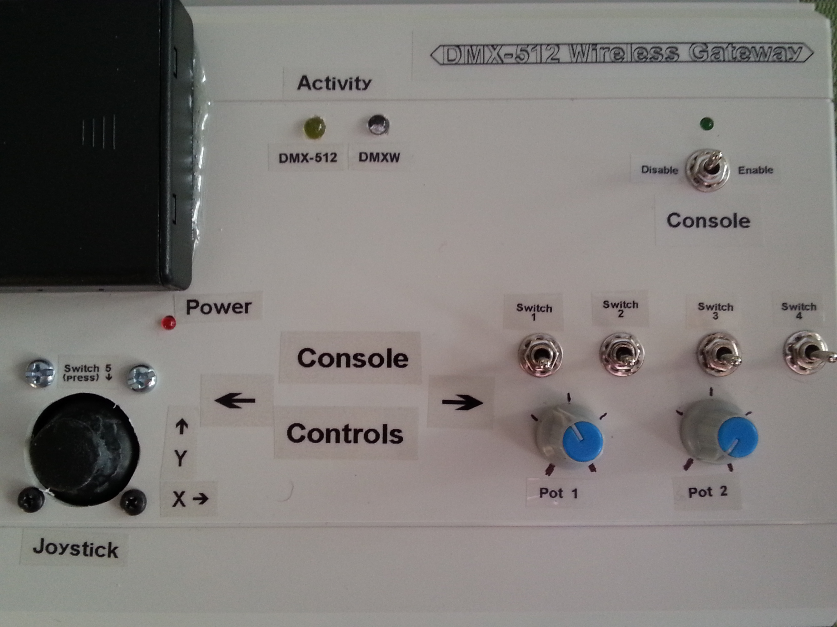

Slide 8
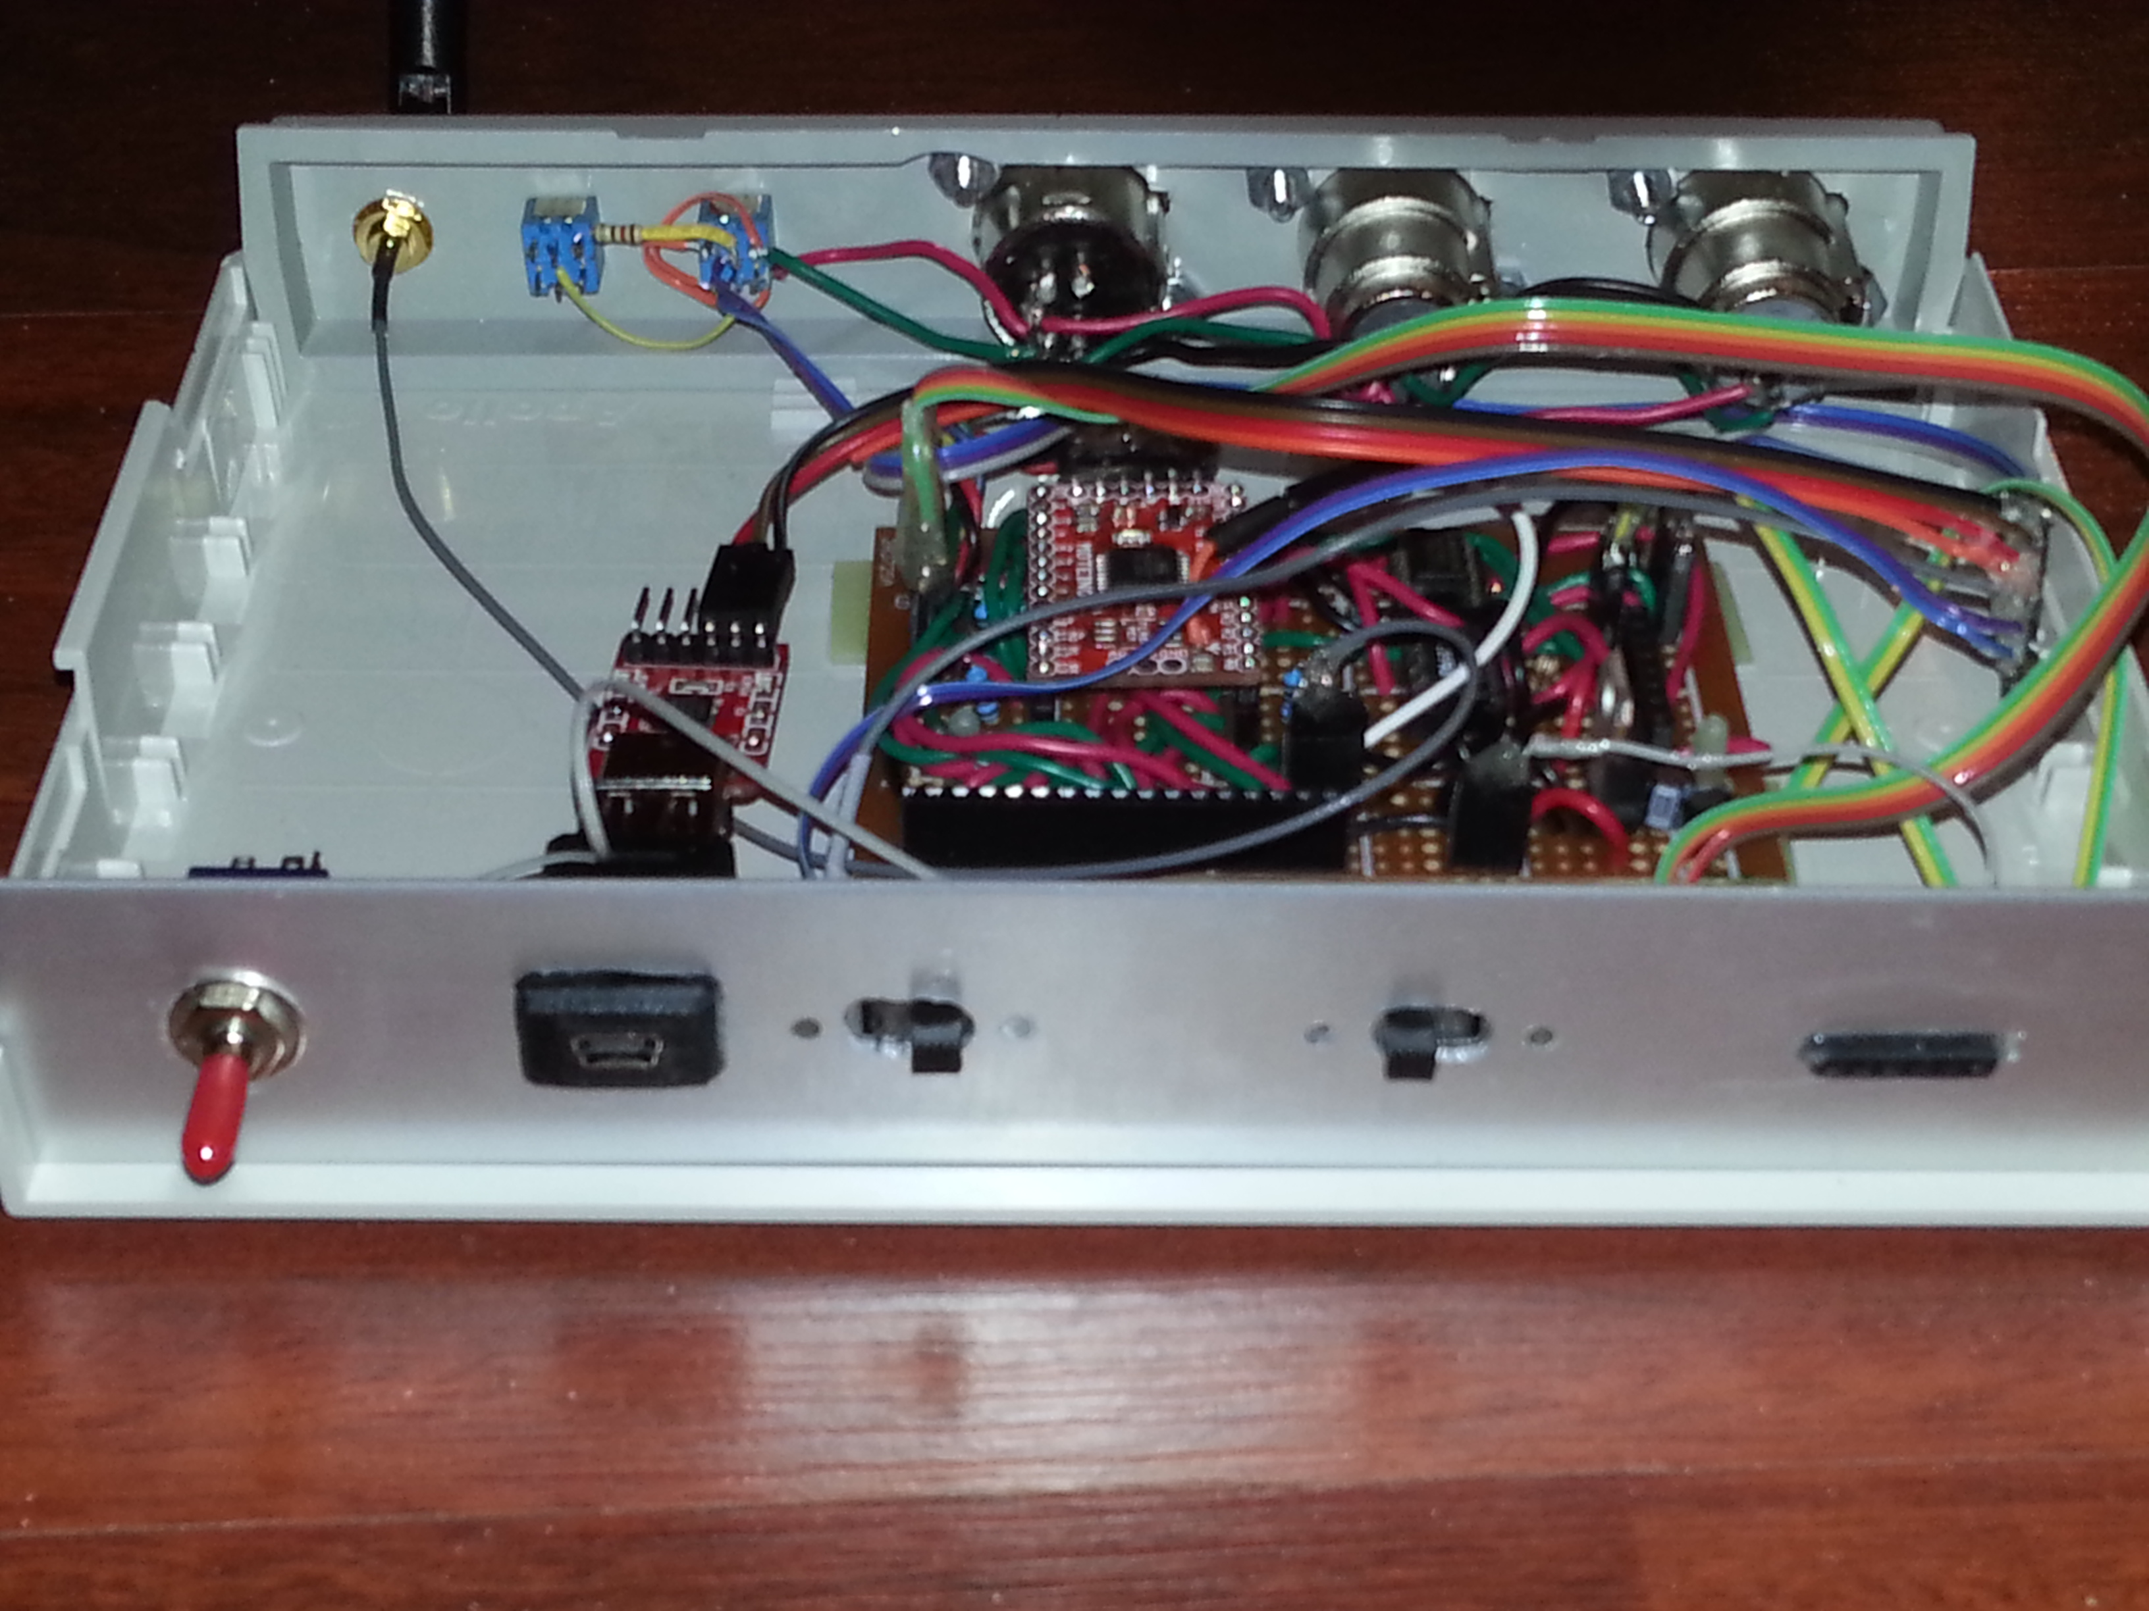

Slide 9
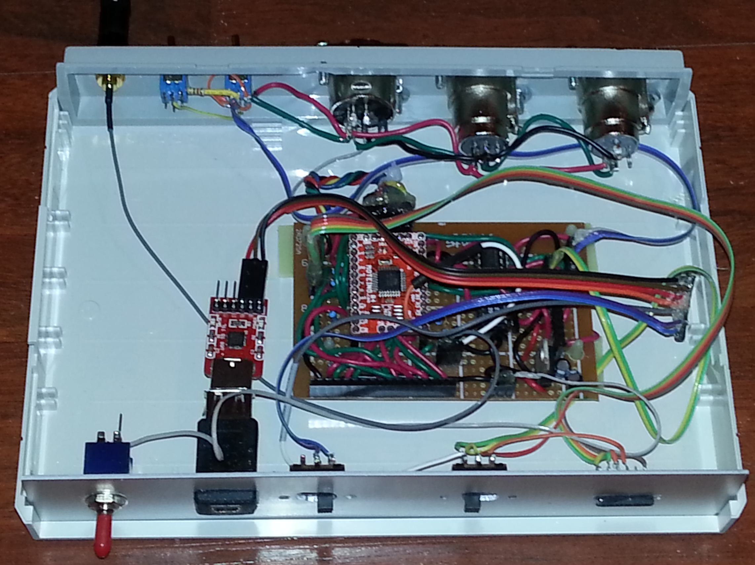

Slide 10
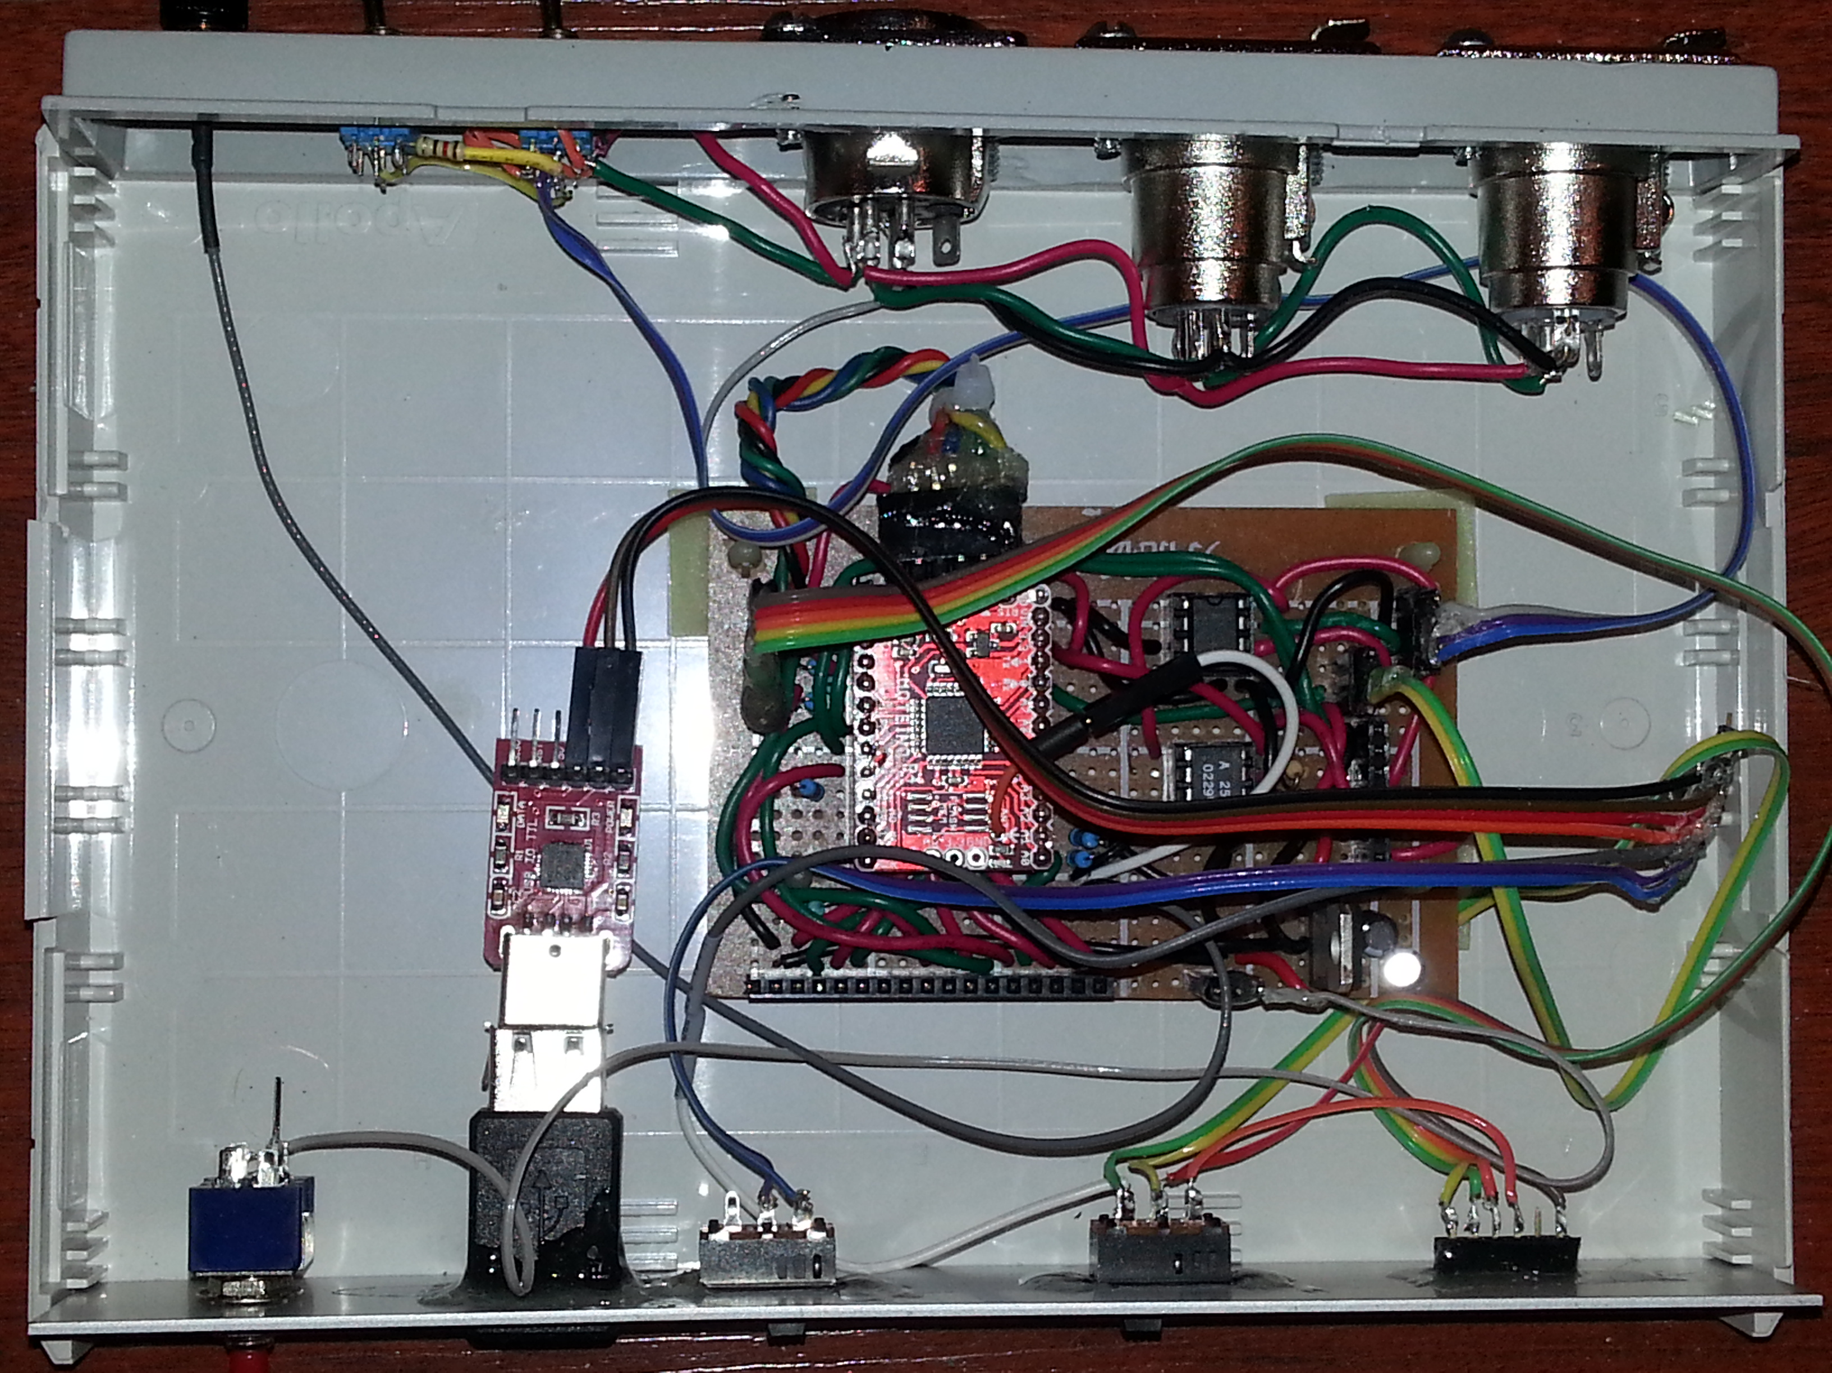

Slide 11
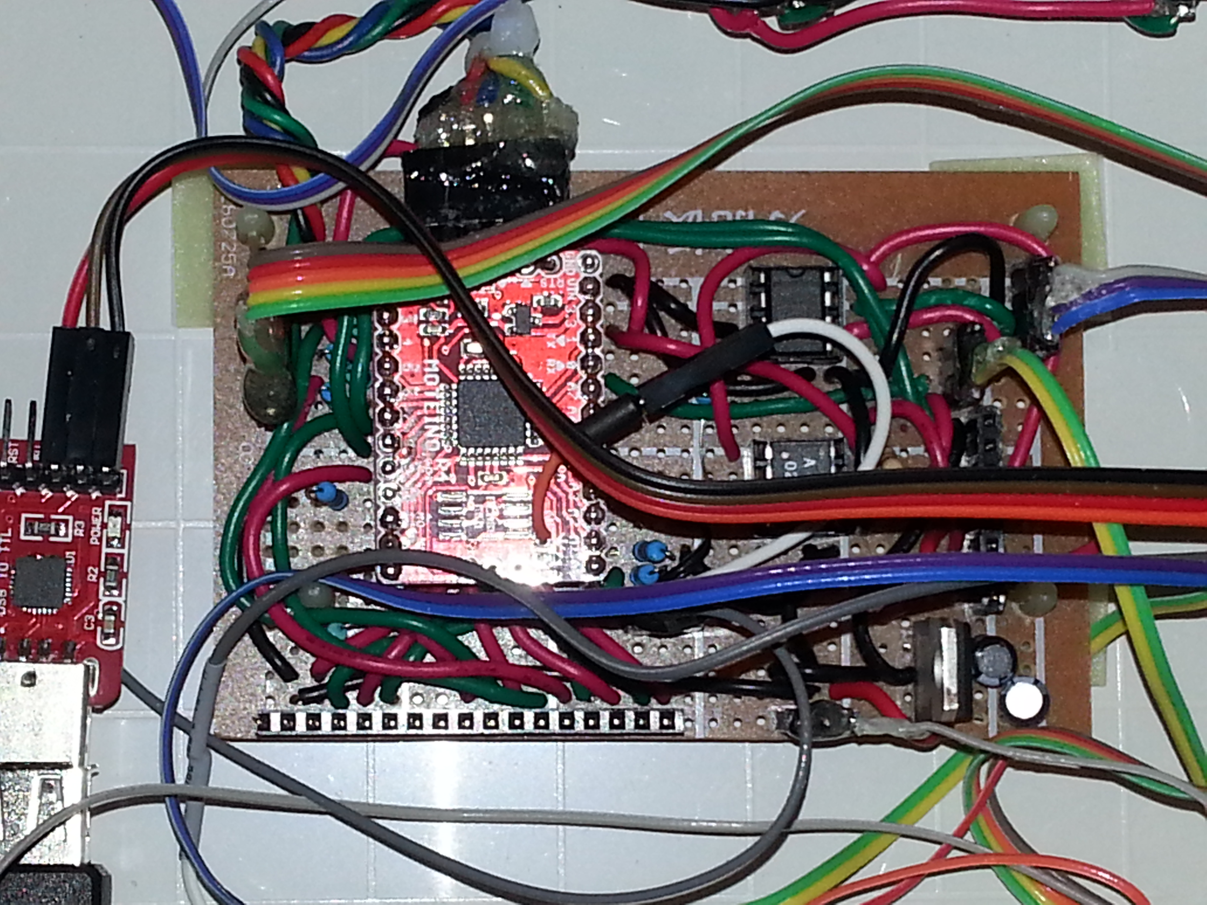
“Antenna Header to Moteino Antenna” Jumper
Moteino Antenna

Slide 12
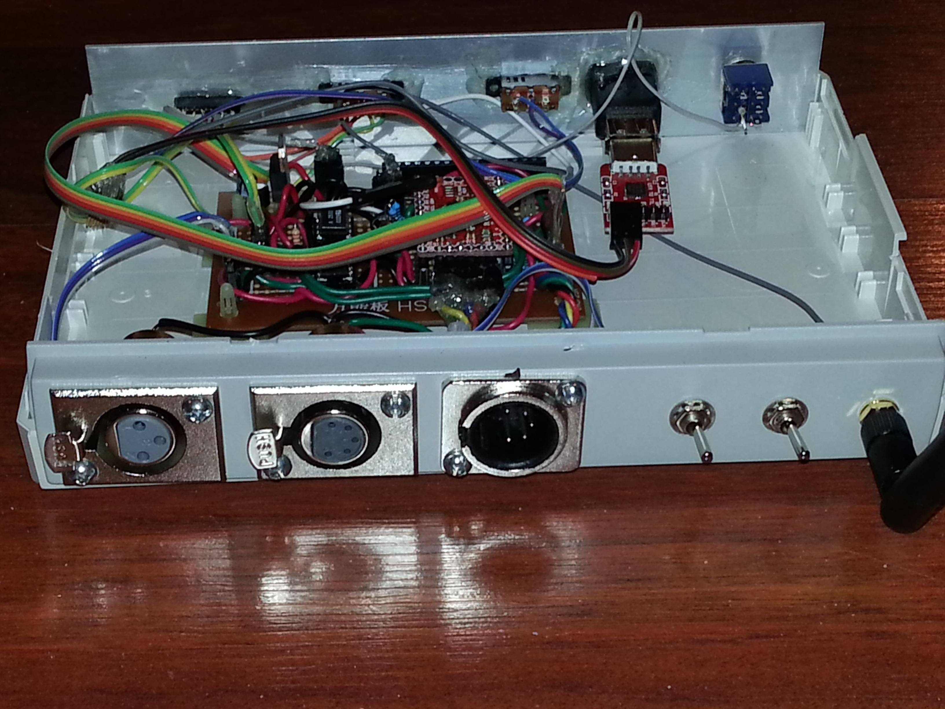

Slide 13
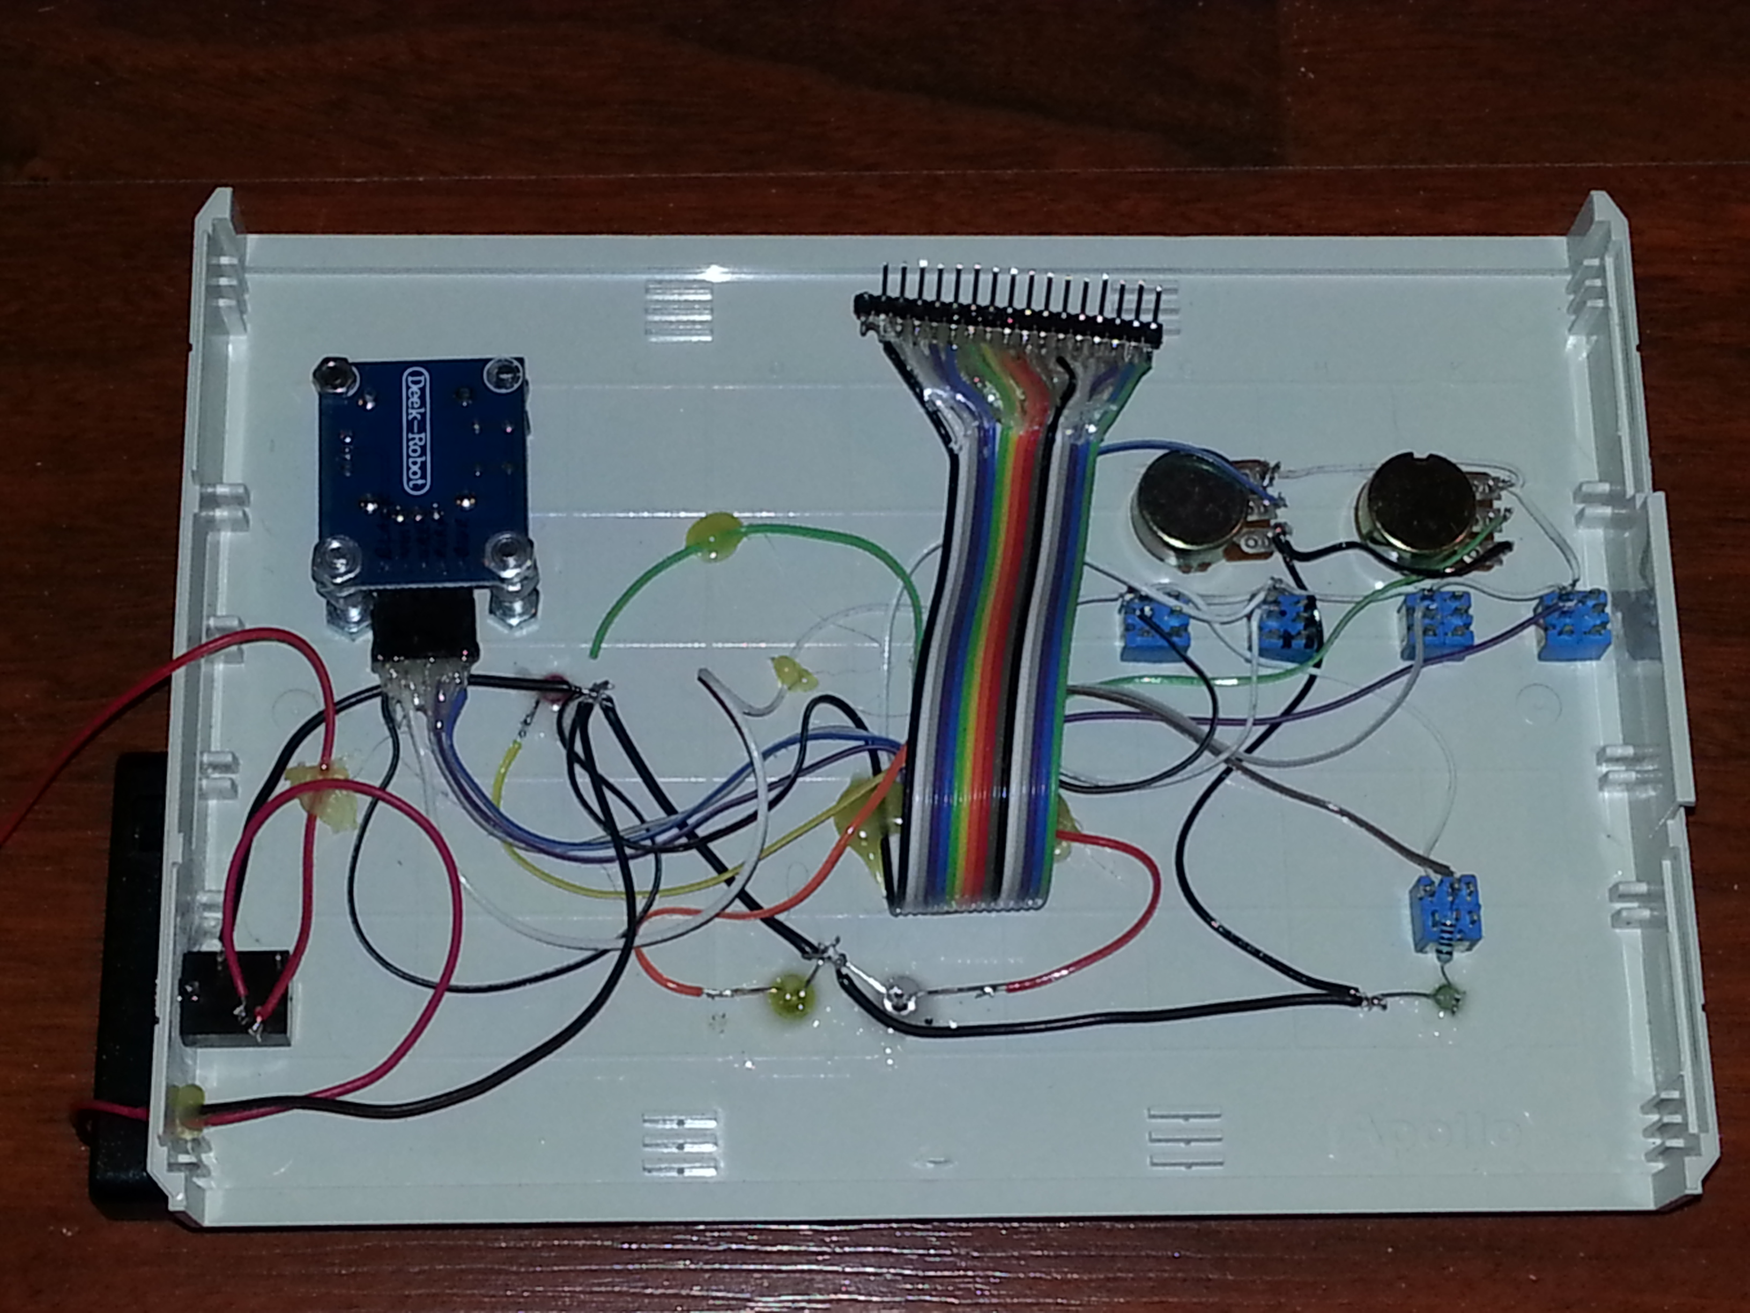
Main I/O Jumper

Slide 14
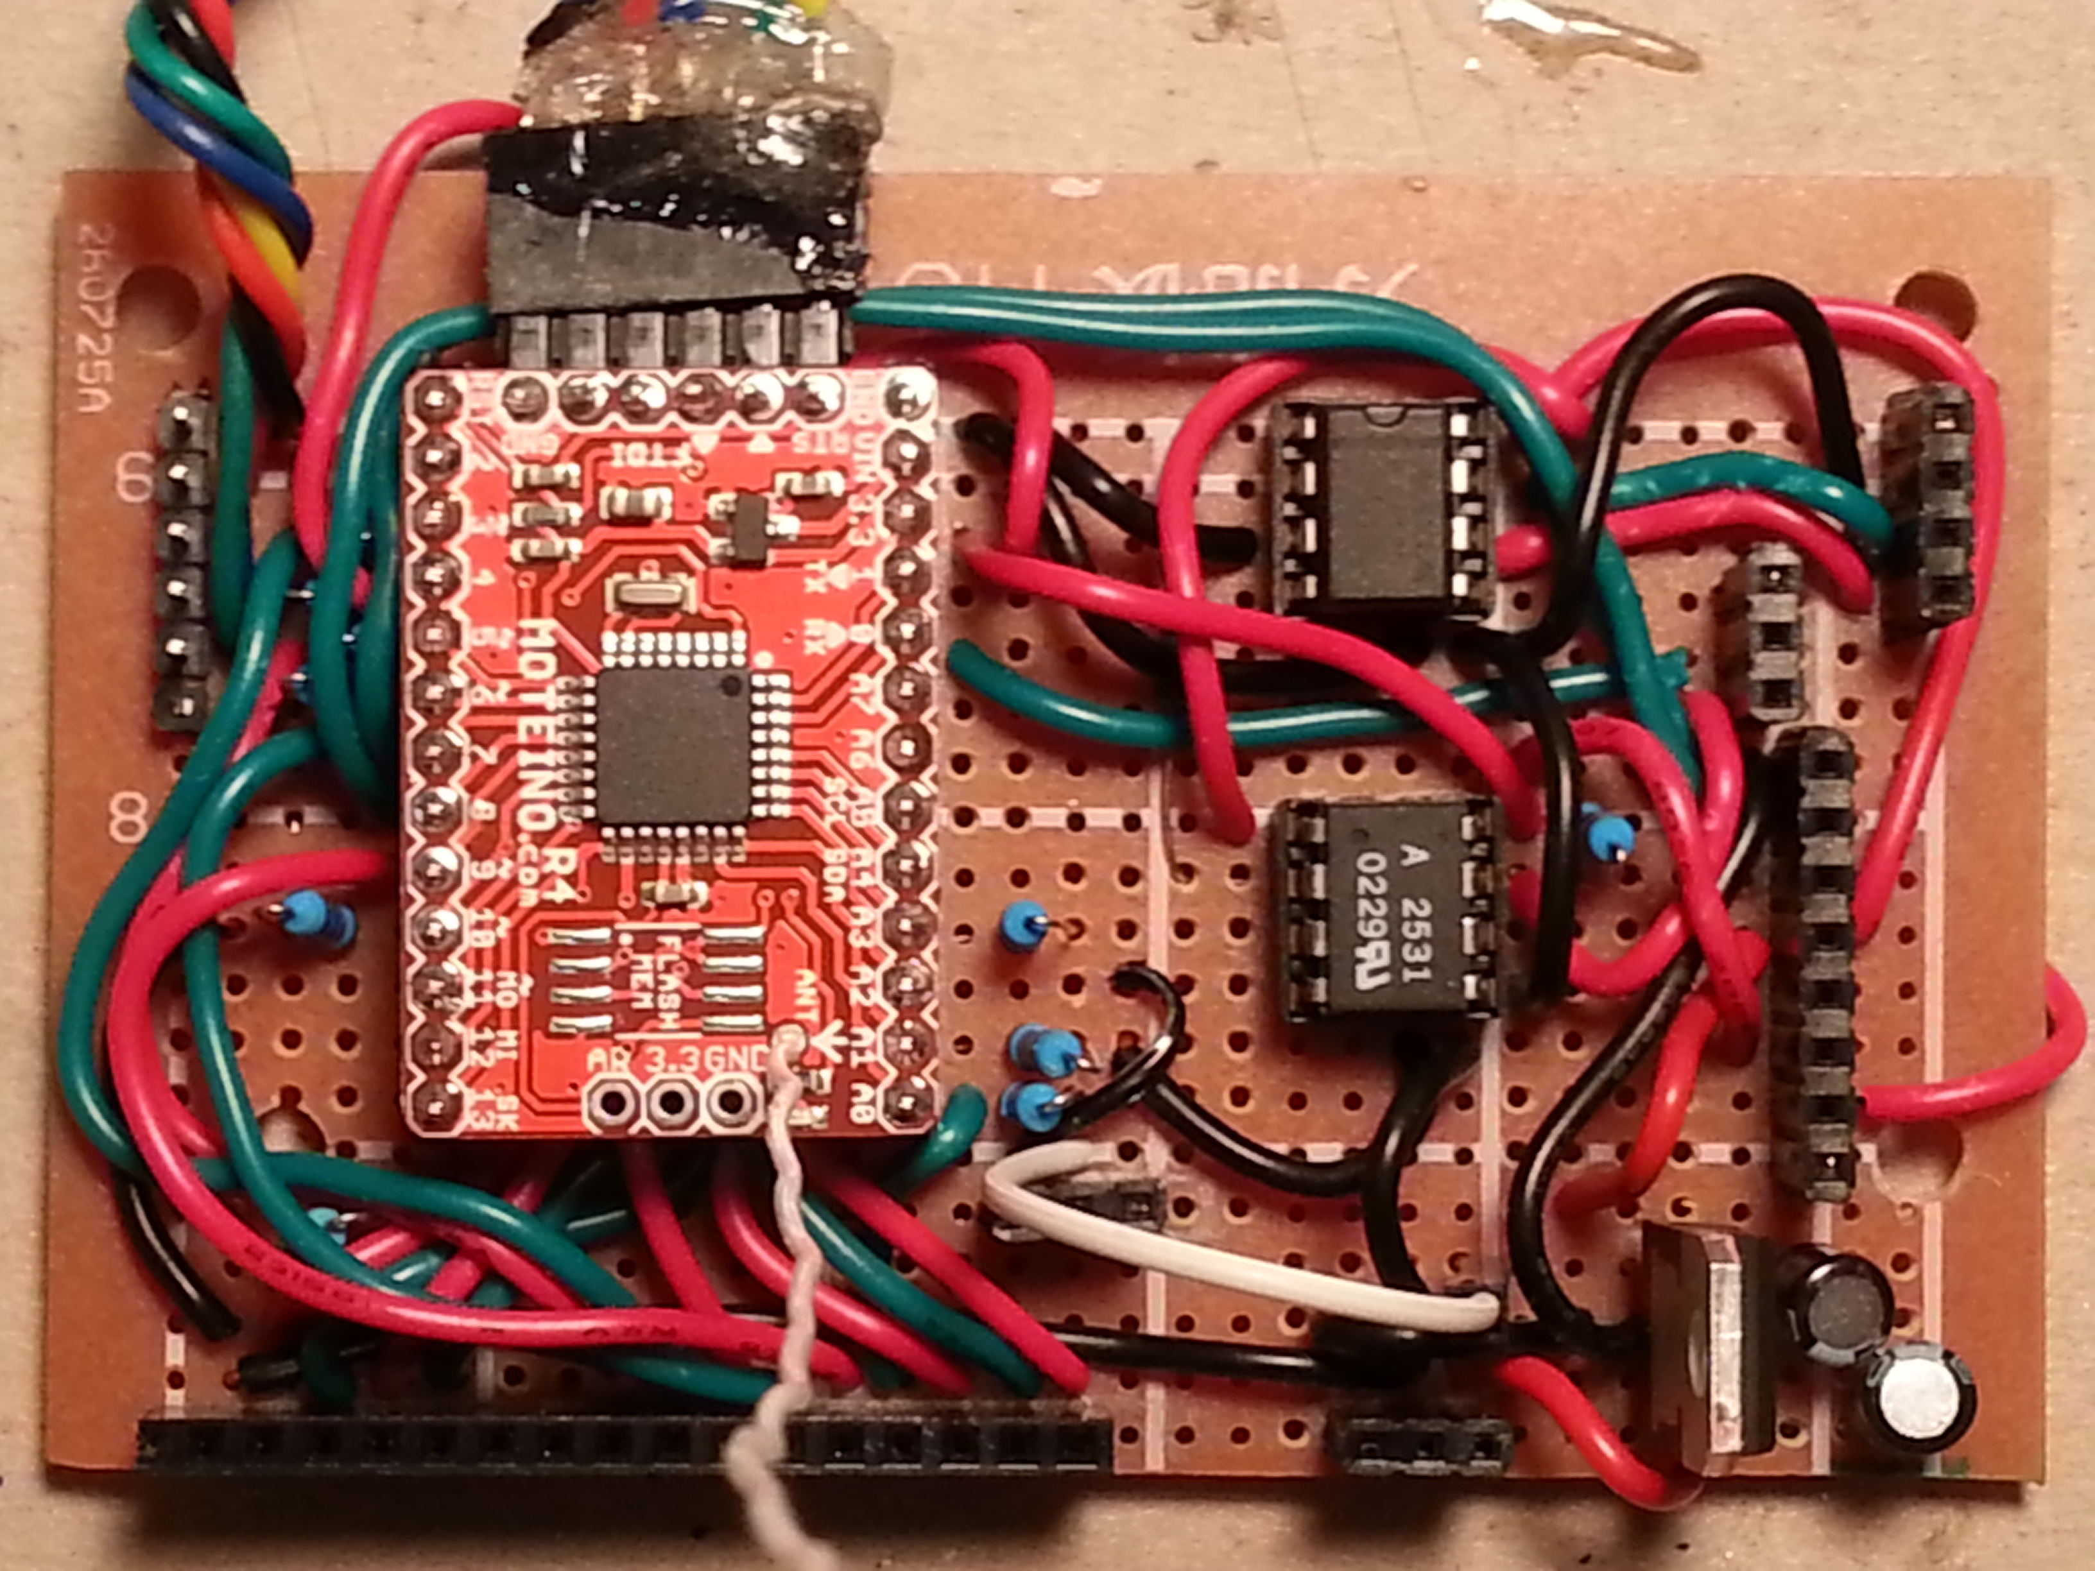

Slide 15
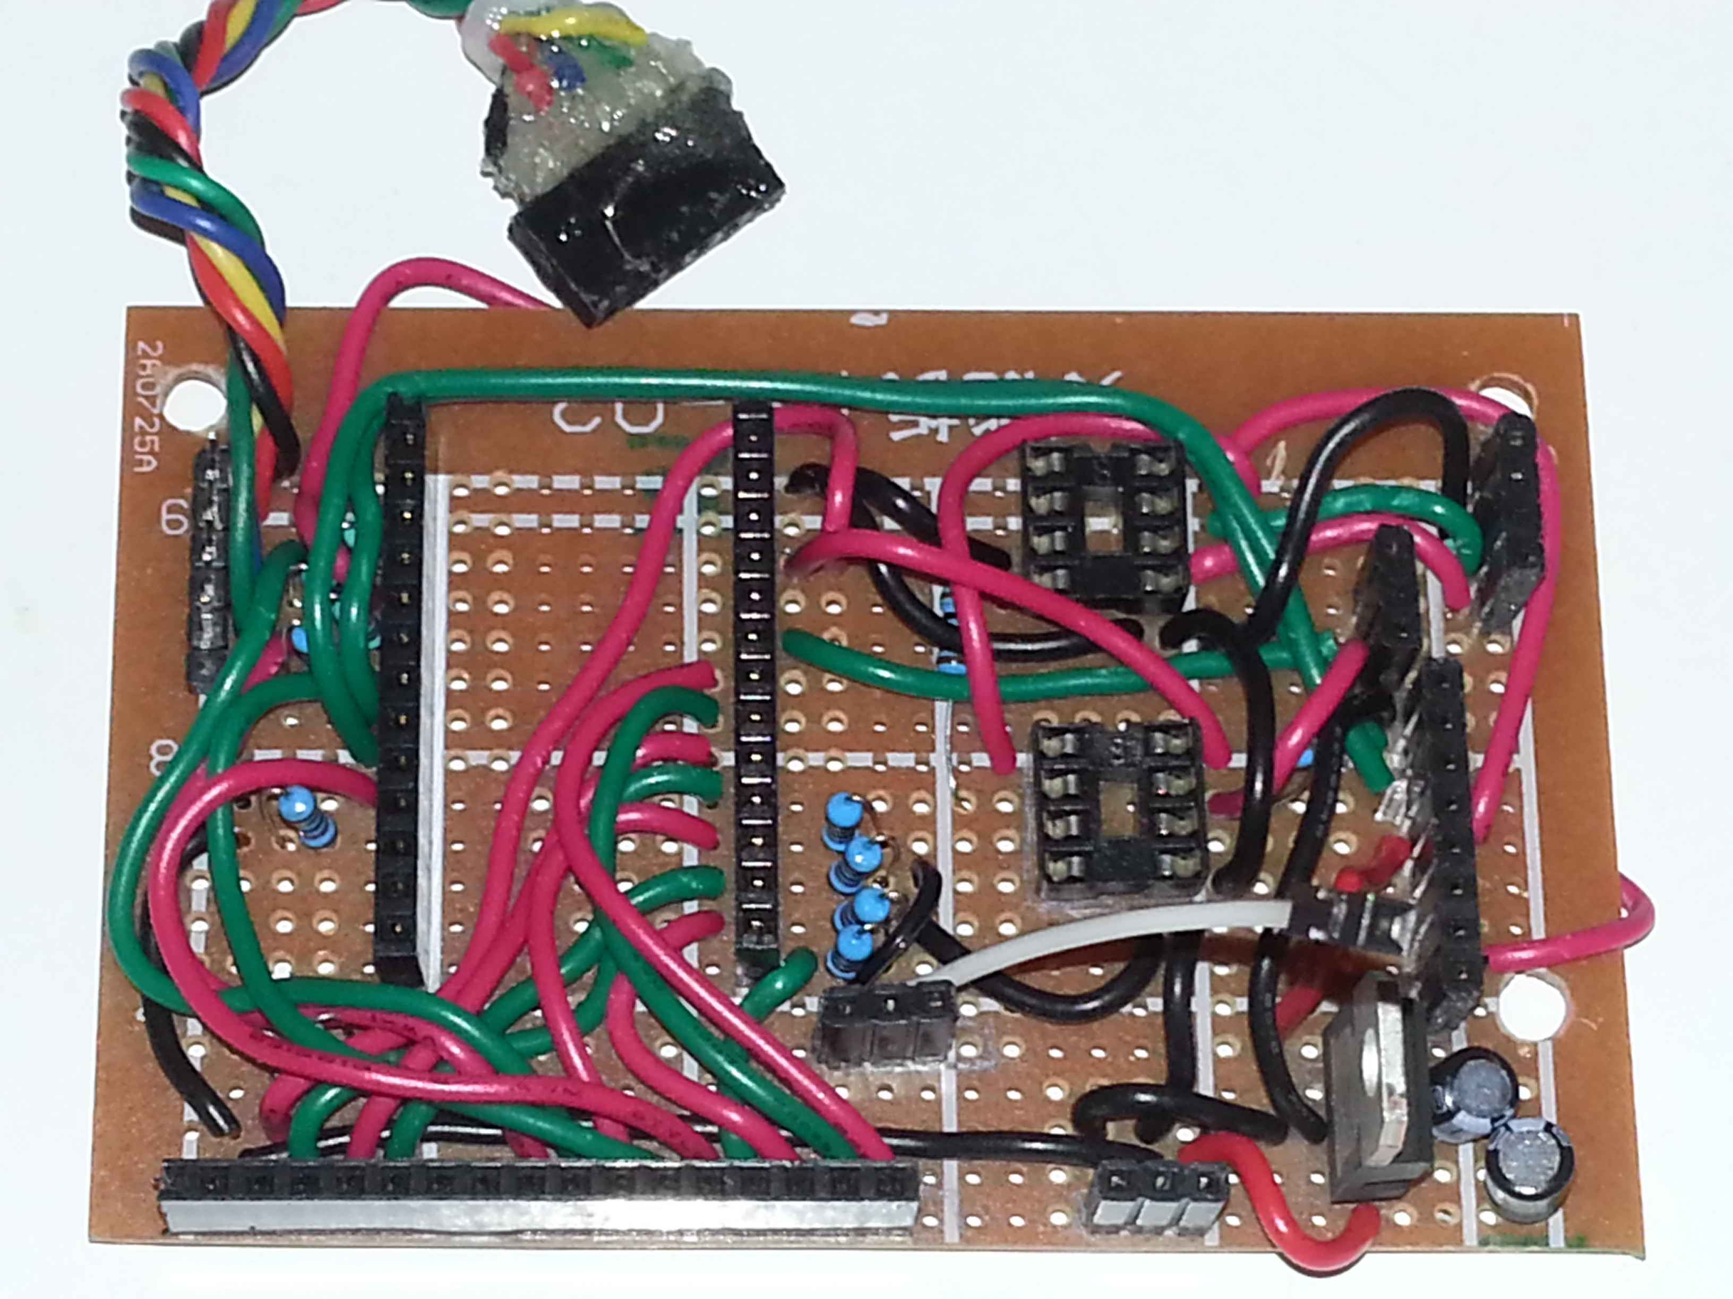
“Antenna Header to Moteino Antenna” Jumper

Slide 16
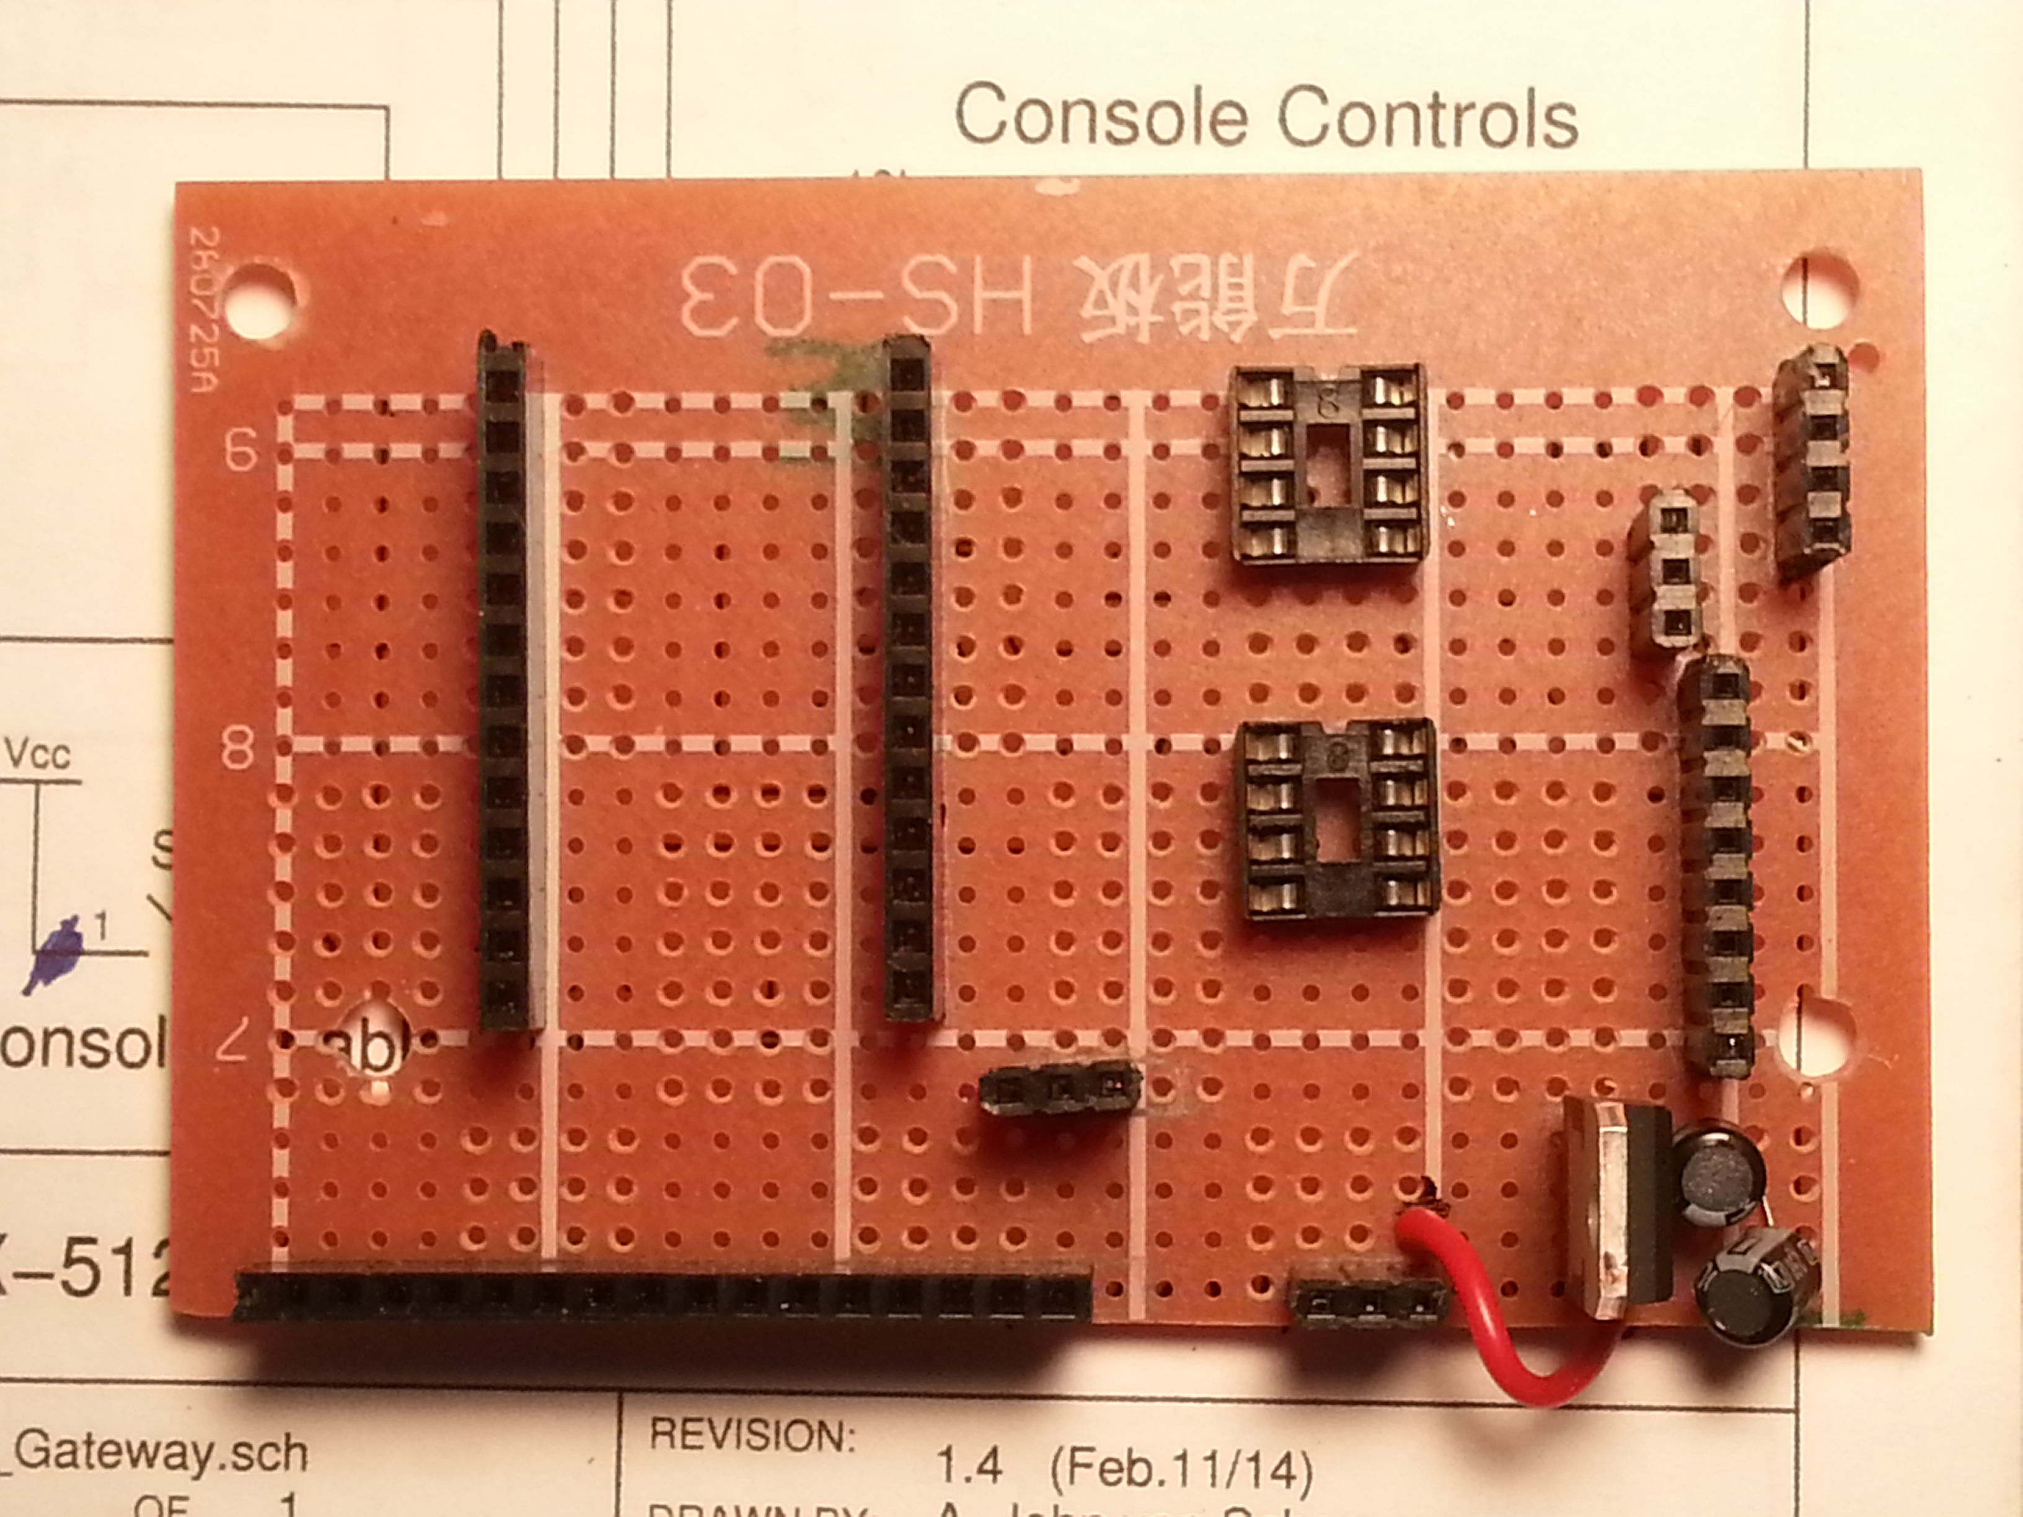
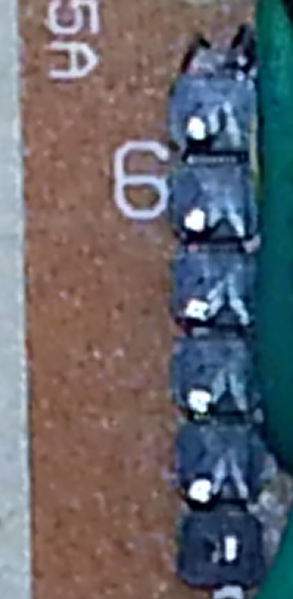
Header and IC Socket Layout
U2
(MAX485)
DMX-512
(Back Panel)
Moteino
+
RFM69
Moteino
+
RFM69
U1
(HCPL2531)
Operating Mode
(Front Panel)
Programming Port
(Front Panel)
Config
(Front Panel)
Main I/O
(Console)
Power Supply
(Right side)
Antenna
(Back Panel)
All headers have orientation: the male end of the connection has a cut-off pin jammed in at one end.

Slide 17
Header & IC Pin Identification
U2:
Pin 1
DMX-512:
Pin 3 (B+)
Moteino:
pin 1
Programming Port: pin 1 (GND)
U1:
Pin 1
Operating Mode:
Pin 1
Config:
Pin 1 (GND)
Main I/O: pin 1 (GND)
Power Supply:
Pin 2 (+ve)
Antenna:
Pin 2 (GND)

Slide 18
Header Pinouts
Programming Port
Programming Header to board
Opposite side of header goes, via connector cable, to Moteino
  GND
  +3.3 – 9 Vdc
  RX (Moteino RX)
  TX (Moteino TX)
  RST

Slide 19
Header Pinouts
Config
  GND
  RX
  TX
  +5 Vdc
  +5 Vdc
  Config Enable Switch (1 of 2)
  Config Enable Switch (2 of 2)

Slide 20
Header Pinouts
Main I/O
GND
Vcc (+3.3 Vdc)
Joystick X-axis [in]
Joystick Y-axis [in]
Joystick button (Switch #5) [in]
n/c
Power LED [out]
DMX-512 Activity LED [out]
  DMXW Activity LED [out]
  Console Enable Sw [in]
  Switch #1 [in]
  Switch #2 [in]
  Switch #3 [in]
  Switch #4 [in]
  Potentiometer #1 [in]
  Potentiometer #2 [in]

Slide 21
Header Pinouts
DMX-512
GND
A (-)
B (+)
Operating Mode
Operating Mode Sw (1 of 2)
Operating Mode Sw (2 of 2)
Antenna
GND
ANT
Power Supply
(raw, unregulated)
GND
+6 – 12 Vdc

Slide 22
DMX-512 Polarity Reversal and Termination Resistor Circuitry
DMX-512
Termination
DMX-512
Polarity Reversal
A (-)
DMX-512
Bus
A (-)
B (+)
To U2 (MAX485)
B (+)
GND
GND

